Slide 2
Learning Objectives (1 of 2)
Define a database and a database management system
Explain logical database design and the relational database model
Define the components of a database management system
Summarize recent trends in database design and use

Slide 3
Learning Objectives (2 of 2)
Explain the components and functions of a data warehouse
Describe the functions of a data mart
Define business analytics and describe its role in the decision-making process
Explain big data and its business applications
Explain database marketing and its business applications

Slide 4
Databases
Database
Collection of related data that is stored in a central location or in multiple locations
Data hierarchy
Structure and organization of data, which involves fields, records, and files
Database management system (DBMS)
Software for creating, storing, maintaining, and accessing database files
Makes using databases more efficient

Slide 5
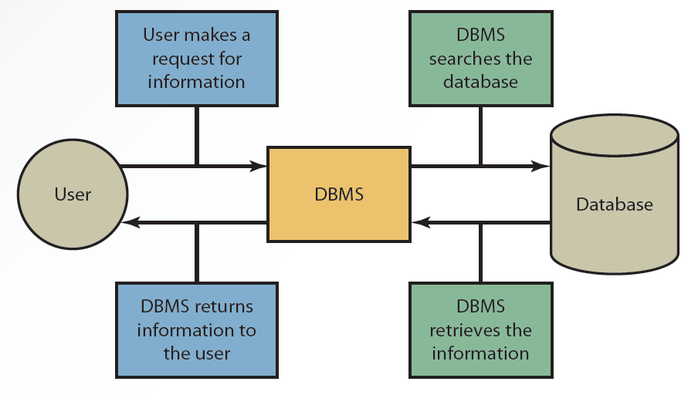
3.2 Interaction between the User, DBMS, and Database

Slide 6
Types of Data in a Database
Internal data
Collected from within an organization
Stored in the organization’s internal databases and can be used by functional information systems
External data
Comes from a variety of sources
Stored in a data warehouse

Slide 7
Methods for Accessing Files (1 of 3)
Sequential access file structure
Records in files are organized and processed in numerical or sequential order
Records are organized based on a primary key (e.g., Social Security numbers or account numbers)
Used for backup and archive files because they rarely need updating

Slide 8
Methods for Accessing Files (2 of 3)
Random access file structure
Records can be accessed in any order, regardless of their physical locations in storage media
Fast and very effective when a small number of records need to be processed daily or weekly
Records are stored on magnetic disks to achieve speed

Slide 9
Methods for Accessing Files (3 of 3)
Indexed sequential access method (ISAM)
Records accessed sequentially or randomly, depending on the number accessed
Random access: used for a small number
Sequential access: used for a large number
Uses an index structure and has two parts
Indexed value
Pointer to the disk location of the record matching the indexed value

Slide 10
Logical Database Design (1 of 3)
Information is viewed in a database in two ways
Physical view: how data is stored on and retrieved from storage media
Logical view: how information appears to users and how it can be organized and retrieved
Depending on the user, there can be more than one logical view of data

Slide 11
Logical Database Design (2 of 3)
Data model determines how data is created, represented, organized, and maintained
Includes:
Data structure
Operations
Integrity rules

Slide 12
Logical Database Design (3 of 3)
Hierarchical model
Relationships between records form a treelike structure
Records are called nodes, and relationships between records are called branches
Network model
Similar to the hierarchical model but records are organized differently
Each record can have multiple parent and child records

Slide 13
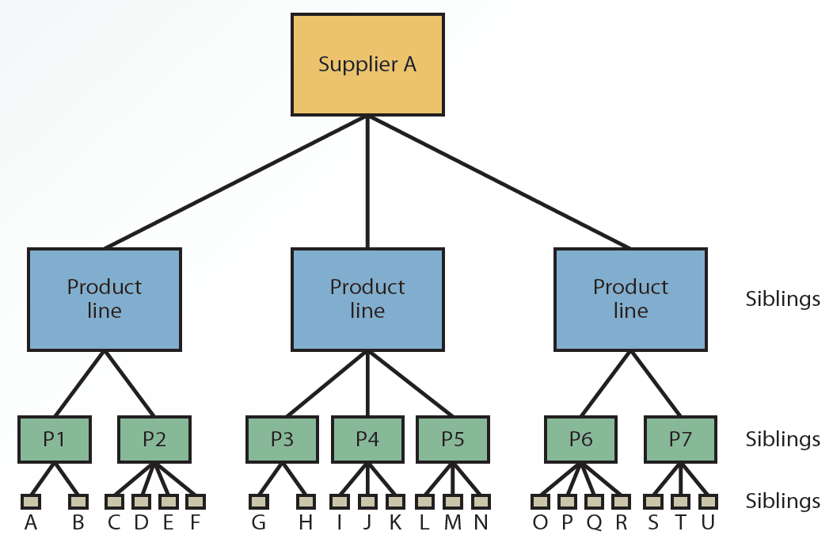
3.3 A Hierarchical Model

Slide 14
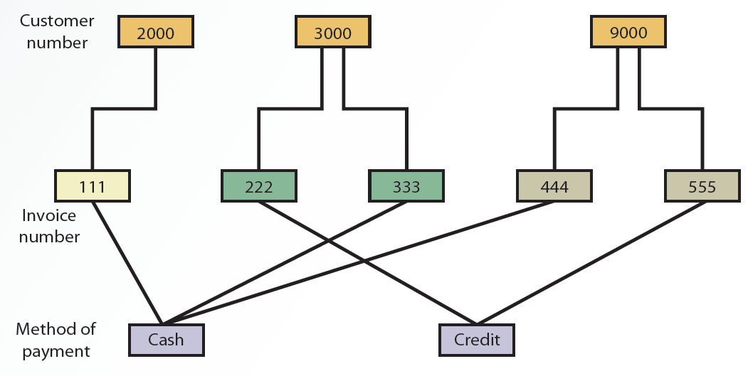
3.4 A Network Model

Slide 15
The Relational Model (1 of 4)
Uses a two-dimensional table of rows and columns of data
Rows are records (i.e., tuples)
Columns are fields (i.e., attributes)
Data dictionary
Stores definitions, such as data types for fields, default values, and validation rules for data in each field

Slide 16
The Relational Model (2 of 4)
Primary key
Uniquely identifies every record in a relational database
Foreign key
Field in a relational table that matches the primary key column of another table
Used to cross-reference tables

Slide 17
The Relational Model (3 of 4)
Normalization
Used to improve database efficiency
Eliminates redundant data
Ensures only related data is stored in a table
Goes through different stages, from first normal form (1NF) to fifth normal form (5NF)

Slide 18
The Relational Model (4 of 4)
Operations
Help retrieve data from tables
Common operations: select, project, join, intersect, union, and difference

Slide 19
Components of a DBMS (1 of 4)
DBMS software components
Database engine
Data definition
Data manipulation
Application generation
Data administration

Slide 20
Components of a DBMS (2 of 4)
Database engine
Responsible for data storage, manipulation, and retrieval
Interacts with other components of the DBMS to convert logical requests from users into their physical equivalents
Data definition
Used to create and maintain the data dictionary and define database file structure
Makes changes to a database’s structure

Slide 21
Components of a DBMS (3 of 4)
Data manipulation
Used to add, delete, modify, and retrieve records from a database
Uses a query language, such as Structured Query Language (SQL)
Application generation
Designs elements of an application using a database
Used by IT professionals and database administrators

Slide 22
Components of a DBMS (4 of 4)
Data administration
Used for tasks such as backup and recovery, security, and change management
Used to determine who has permission to perform certain functions, summarized as create, read, update, and delete (CRUD)
Database administrators (DBAs)
Handle database design and management

Slide 23
Recent Trends in Database Design and Use
Include:
Data-driven Web sites
Natural language processing
Distributed databases
Object-oriented databases
Advances in artificial intelligence

Slide 24
Data-Driven Web Sites
Acts as an interface to a database
Retrieves data and allows users to enter data in the database
Improves access to information
Reduces support and overhead needed to maintain static Web sites
Gives users more current information from a variety of data sources

Slide 25
Distributed Databases (1 of 2)
Distributed Database Management System (DDBMS)
Stores data on multiple servers throughout an organization
Several advantages
Design better reflects the firm’s structure
Local data storage reduces response time
Minimizes effects of computer failure
Cost advantage
Not limited by physical location of the data

Slide 26
Distributed Databases (2 of 2)
Approaches to setting up a DDBMS
Fragmentation: addresses how tables are divided among multiple locations
Replication: each site stores a copy of the data in the organization’s database
Allocation: combines fragmentation and replication

Slide 27
Object-Oriented Databases (1 of 2)
Data and their relationships are contained in a single object
Object consists of attributes and methods that can be performed on the object’s data
Encapsulation: grouping objects along with their attributes and methods into a class
Inheritance: new objects can be created faster and more easily by entering new data in attributes

Slide 28
Object-Oriented Databases (2 of 2)
Advantages of object-oriented database
Supports more complex data management
Handles storing and manipulating all types of multimedia as well as numbers and characters

Slide 29
Data Warehouses (1 of 2)
Collection of data from a variety of sources
Support decision-making applications
Generate business intelligence
Called hypercubes because they store multidimensional data

Slide 30
Data Warehouses (2 of 2)
Characteristics of data in a data warehouse
Subject oriented
Comes from a variety of sources
Categorized based on time
Captures aggregated data
Used for analytical purposes

Slide 31
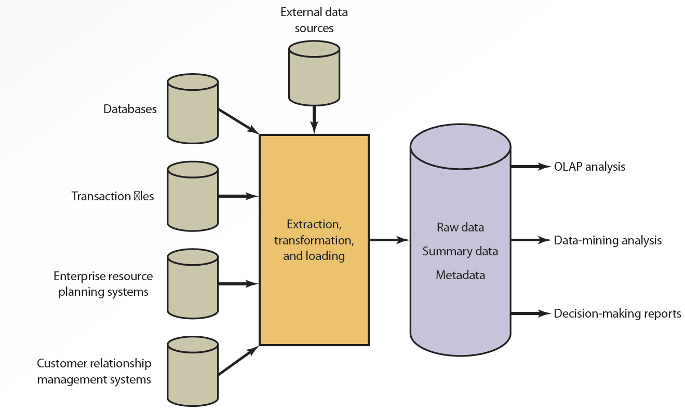
3.6 A Data Warehouse Configuration

Slide 32
Input
Different data sources provide the input for a data warehouse to perform analyses and generate reports
External data sources, databases, and transaction files
Enterprise resource planning (ERP) systems
Customer relationship management (CRM) systems

Slide 33
ETL
Extraction, transformation, and loading
Processes used in a data warehouse
Collecting data from a variety of sources
Converting data into a format that can be used in transformation processing
Loading data into the data warehouse

Slide 34
Storage
Collected information is organized in a data warehouse as:
Raw data: information in its original form
Summary data: gives users subtotals of various categories
Metadata: information about data’s content, quality, condition, origin, and other characteristics

Slide 35
Output (1 of 3)
Data warehouses use the following to generate reports:
Online analytical processing (OLAP)
Uses multiple sources of information and provides multidimensional analysis
Generates business intelligence
Data-mining analysis
Used to discover patterns and relationships

Slide 36
Output (2 of 3)
Benefits of data warehouses
Cross-reference segments of an organization’s operations for comparison
Generate complex queries and reports faster than when using databases
Generate reports efficiently using data from a variety of sources
Find patterns and trends that cannot be found with databases

Slide 37
Output (3 of 3)
Analyze large amounts of historical data quickly
Assist management in making well-informed business decisions
Manage a high demand for information from many users with different needs and decision-making styles

Slide 38
Data Marts (1 of 2)
Smaller version of a data warehouse, used by a single department or function
Advantages over data warehouses
Faster access to data owing to its smaller size
Improved response time for users
Easier to create because of its size and simplicity
Less expensive
Effective targeting of users

Slide 39
Data Marts (2 of 2)
Disadvantages
Limited scope
Difficulty in consolidating information from different departments or functional areas

Slide 40
Business Analytics (1 of 3)
Uses data and statistical methods
Gains insight into the data
Provides decision makers with information to act on
Methods
Descriptive
Predictive
Prescriptive

Slide 41
Business Analytics (2 of 3)
Descriptive analytics
Reactive strategy
Reviews past events, analyzes the data, and provides a report indicating:
What happened in a given period of time
How to prepare for the future

Slide 42
Business Analytics (3 of 3)
Predictive analytics
Proactive strategy
Prepares decision makers for future events
Prescriptive analytics
Recommends a course of action that decision makers should follow
Shows the likely outcome of each decision

Slide 43
The Big Data Era (1 of 3)
Voluminous data
Conventional computing methods are unable to efficiently process and manage it
Involves five dimensions
Volume
Variety
Velocity
Veracity
Value

Slide 44
The Big Data Era (2 of 3)
Provides competitive advantage in many areas
Retail, financial services, advertising and public relations, government, manufacturing, healthcare, etc.
Many technologies and applications have contributed to growth and popularity
Mobile and wireless technology, the popularity of social networks, etc.

Slide 45
The Big Data Era (3 of 3)
Executives should guard against privacy risks
Discrimination, privacy breaches and embarrassments, unethical actions based on interpretations, loss of anonymity, etc.

Slide 46
Database Marketing (1 of 3)
Uses an organization's database of customers and potential customers to promote products or services
Main goal: use information within the database to implement marketing strategies
Increase profits
Enhance competitiveness

Slide 47
Database Marketing (2 of 3)
Transforms marketing from a reactive to a proactive process
Multivariate analysis
Data segmentation
Automated tools

Slide 48
Database Marketing (3 of 3)
Tasks performed by successful database marketing campaigns
Calculating customer lifetime value (CLTV)
Conducting recency, frequency, and monetary analysis (RFM)
Using different techniques to communicate effectively with customers
Using different techniques to monitor customer behavior across a number of retail channels

Slide 49
Summary (1 of 2)
All files are integrated in a database, which enables faster retrieval of data
Components of a DBMS are database engine, data definition, data manipulation, application generation, and data administration
Recent trends in database design are data-driven Web sites, natural language processing, and distributed and object-oriented databases

Slide 50
Summary (2 of 2)
Data warehouse is a collection of data from a variety of sources
Data marts focus on business functions for a specific user group in an organization
Industries gain a competitive advantage from big data analytics

